Slide 1
Business Process Engineering
Week 02

Slide 2
Administration and Stakeholders
The business process domain is characterized by several types of stakeholders with different knowledge, expertise, and experience; these are classified into the following roles:
Chief Process Officer: Top level management.
Business Engineer : Must have a nontechnical educational background
Process Designer: Process designers are responsible for modelling business processes by communicating with business domain experts and other stakeholders
Process Participant:
Knowledge Worker
System Architect
Developers

Slide 3
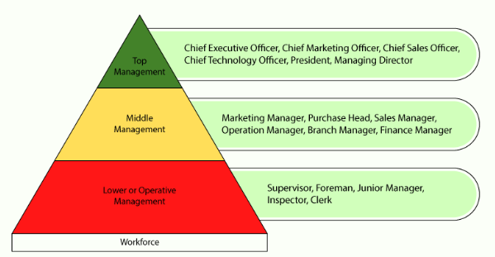
Level of Management

Slide 4
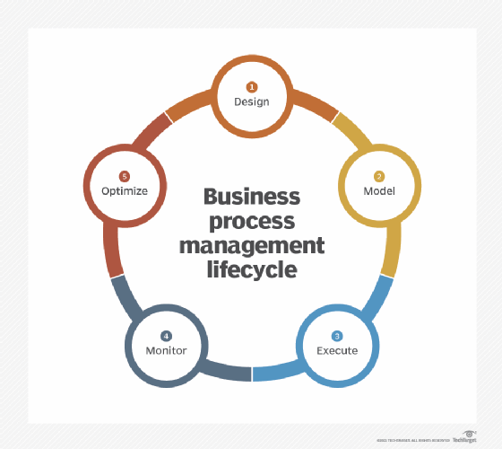
BPM lifecycle
BPM consists of several steps. Many BPM experts refer to these five:
Create a plan: (Primary , Secondary, Management )
Analyze the processes of your organization (qualitative, quantitative )
Design the ideal model
Implement
Monitor

Slide 5
What BPM is Not
BPM is not a software product
BPM is not Task Management

Slide 6
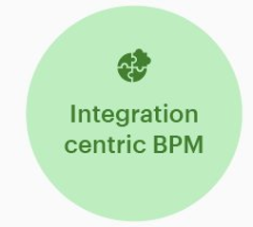
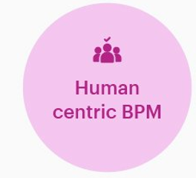
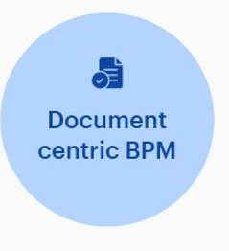
Types of BPM

Slide 7

1. Document-centric BPM
A document-centric process is one where a document like a contract or legal agreement is at the heart of that process. Document-centric processes define procedures for distributing, reviewing, and validating documents.
A good example would be the process for approving and signing customer contracts or contracts signed while procuring the services of external vendors.

Slide 8
2. Human-centric BPM
Human-centric processes are those that have the most involvement and interaction performed by humans. They are generally decision-based instead of rules-based processes; humans decide the process's path based on their decisions.
An example of a human-centric process in an organization is hiring new talent by the Human Resources team.
Human-centric-BPM
The decision-based nature of human-centric processes presents challenges where automation is concerned. Whereas automation teams are beginning to ramp up their use of intelligent automation, this type of automation is still very much in the experimental stage and not quite ready for prime time.

Slide 9

3. Integration-centric BPM
Integration-centric processes define the transfer of information and data between different systems without significant human intervention. These processes lend themselves very well to automation, increasing the speed of execution and limiting errors based on humans' decreased involvement.
Integration-centric-BPM
An excellent example of an integration-centric process is the connection between marketing tools like HubSpot or Marketo with sales-based CRMs (client relationship manager) like Salesforce or Siebel to transfer data on lead generation and engagement between those two systems.

Slide 10
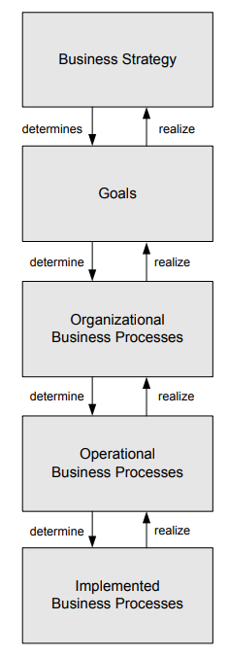
Levels of business processes: from business strategy to implemented business processes
At the highest level, the strategy of the company is specified, which describes its long-term concepts to develop
These goals can be organized, so that each goal can be divided into a set of sub-goals. Reducing the cost for supplied materials is a sample goal
These business processes act as supplier or consumer processes the activities and their relationships are specified
Implemented business processes contain information on the execution of the process activities and the technical and organizational environment in which they will be executed.

Slide 11
Intraorganizational Processes versus Process Choreographies
Single organization. If there is no interaction with business processes performed by other parties, then the business process is called intraorganizational.
Interact with business processes in other organizations, forming process choreographies.

Slide 12
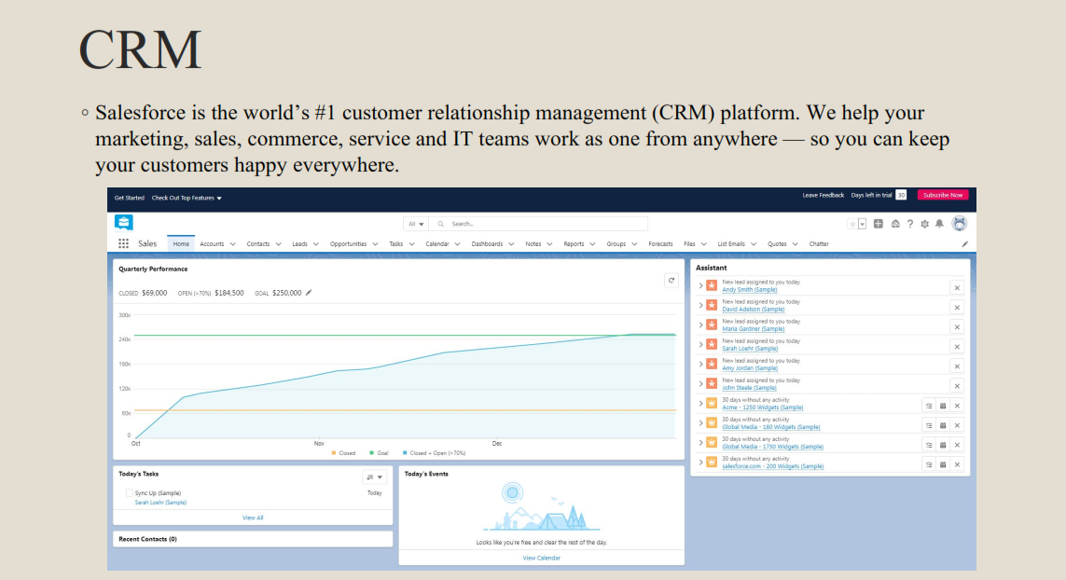

Slide 13
ERP
Enterprise Resource Planning (ERP) software systems are used by companies to oversee, customize and automate time-consuming daily activities.
In many ERP systems, these common functional areas are grouped into ERP modules, including but not limited to:
◦
◦ Financial Accounting
◦ Management Accounting
◦ Human Resources
◦ Manufacturing
◦ Order Processing
◦ Supply Chain Management
◦ Project Management
◦ Customer Relationship Management (CRM)
◦ Data Services

Slide 14
Two aspects to operational management of business processes
1. Management of business processes as an integral part of ‘management’
2. Management of business process improvement.

Slide 15
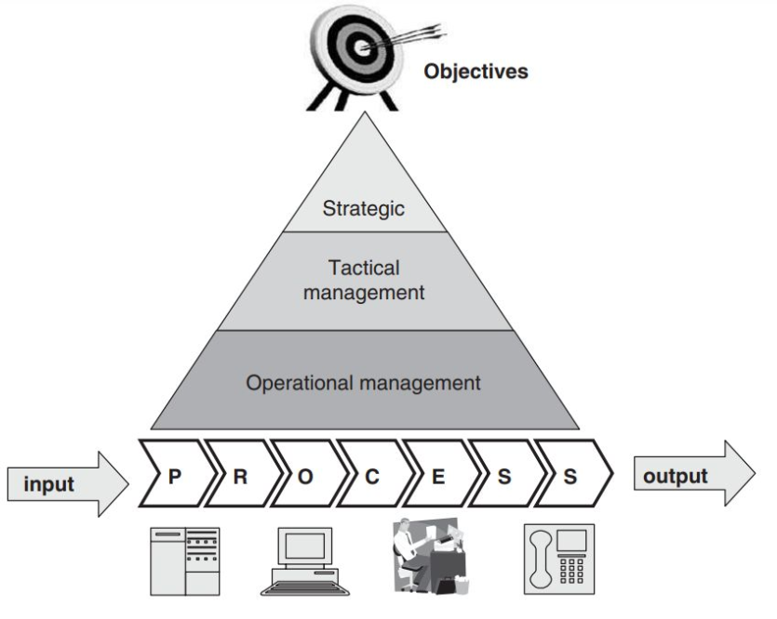
Strategic managers will be looking at the business model and the related processes.
Tactical managers will be looking at improvements of the processes.
Line Managers
Operational managers should be working with clearly defined processes and related objectives.

Slide 16
Responsibilities
1. specifying objectives (goals) and measures that relate to the objectives and targets to be achieved
– these targets should be broken down into daily or weekly measures to enable continuous monitoring and management
2. communicating the objectives, measures and targets to the people executing the processes and, if necessary, providing rewards and incentives
3. monitoring and managing progress of the targets, and verifying whether the objectives and measures are still accurate and relevant
4. motivating staff to exceed objectives and deal with process disturbances
5. encouraging staff to identify bottlenecks and possible process improvements.

Slide 17
Why are organizational strategy and process architecture important in BPM implementation?
◦ Organizational Strategy due to:
◦ Sets Direction And Priorities
◦ Aligns Teams And Departments In A Common Goal
◦ Clarifies And Simplifies Decision Making
◦ Allows Your Business To Adapt
◦ Process Architecture
◦ A good process architecture will ensure that more time and effort is saved by its use. It will also provide a
means of communicating, specifying and agreeing the process objectives and principles in a way that it is
clear for everyone. Where process architecture already exists, it will be much easier to identify the impact
of the suggested changes against the agreed standard.

Slide 18
Organizational Strategy
◦ An organizational strategy is an action plan for how a company will achieve its long-term goals.
◦ Organizational strategy is a plan that specifies how your business will allocate the following resources :
◦ Money
◦ Labor
◦ inventory

Slide 19
Organizational Strategy Categories
When you sit down to create your organizational strategy, you should first divide it into three distinct
categories:
1. Corporate level strategy:
a. The Corporate Level is the highest level in any organization, so choices here will impact the main
business goal.
b. Business leaders here identify the actions to take that will best position the organization to meet the
marketplace’s needs
2. Business level strategy:
a. At the Business Level, managers identify how a company is going to react to a market and bring value to
its customers.
3. Functional level strategy:
a. daily operations and ensuring they are aligned with the organization’s higher-level goals.

Slide 20
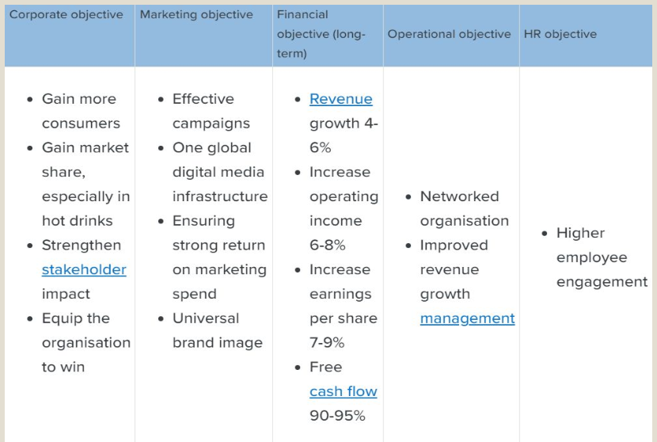
Example

Slide 21
Process Architecture
Process architecture is much more than a process model;
it also includes the objectives, principles, strategies and guidelines that are the foundation of the
models.
A process model is just a snapshot of the current thinking, and does not provide sufficient guidance for
reviewing existing or creating new processes.

Slide 22
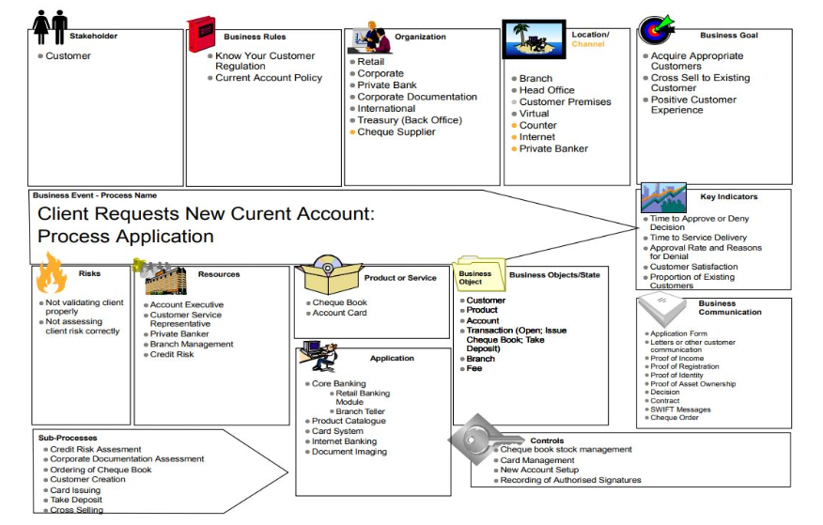

Slide 23
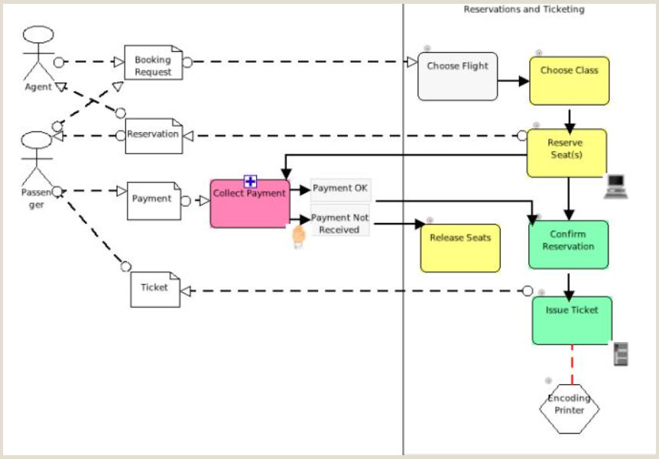
Process Model

Slide 24
How do you sell BPM technology to the organization?

Slide 25
Who is buying BPM technology?
Business manager can buy an automated BPM solution. Generic arguments for any business
manager include the following:
a. BPM technology provides business process transparency
b. the business becomes more agile

Slide 26
Outcome
1. productivity is increased at a lower cost
2. compliance can be provided
3. customer service is improved.
With BPM technology, the earlier investment in IT applications will not be wasted
BPM will link these independent applications together
More responsive to the changing business requirements
New applications can be provided faster, cheaper and more flexibly

Slide 27
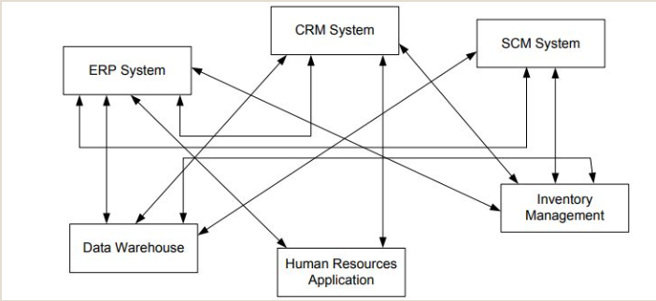

Slide 28
